Slide 1
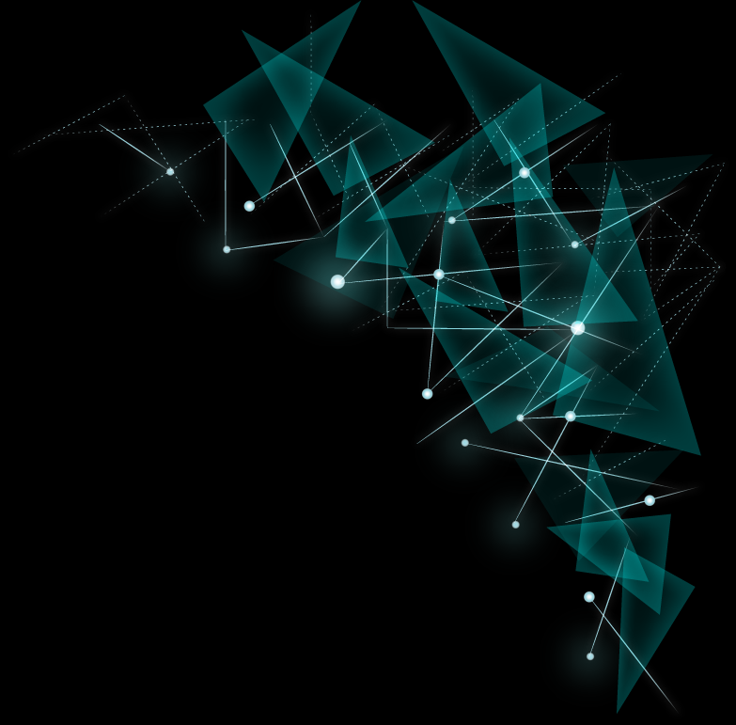
Kubernetes Scheduler

Slide 2
Agenda
Kubernetes Scheduling Overview
Scheduler Framework
Write a Scheduler Plugin
Sig-Scheduling subprojects

Slide 3
Kubernetes Scheduling Overview

Slide 4
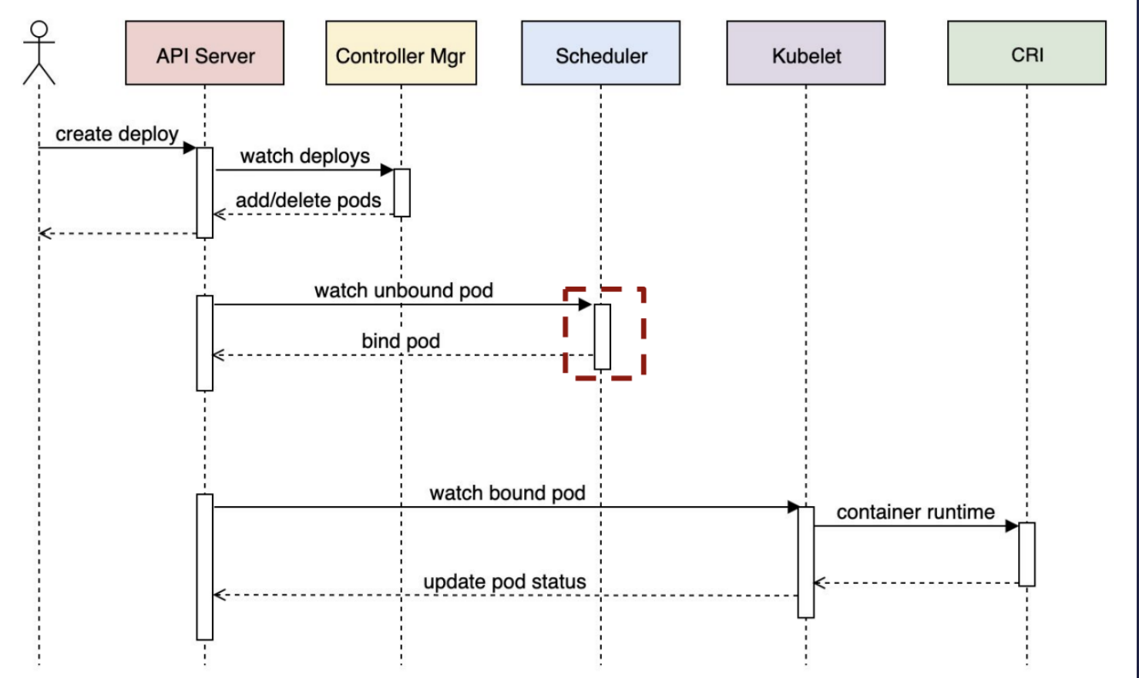
Pod Lifecycle

Slide 5
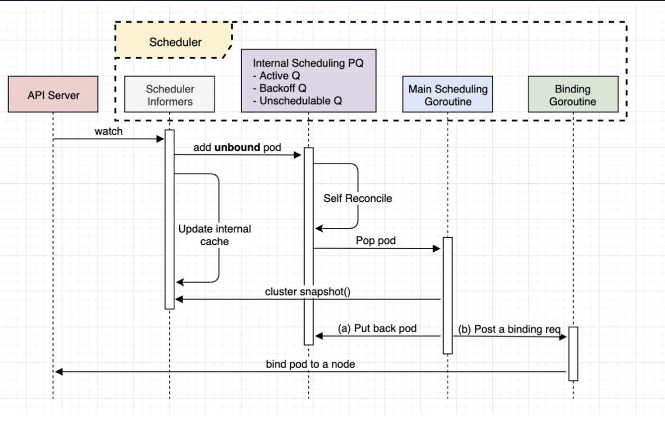
Scheduler Workflow Internals

Slide 6
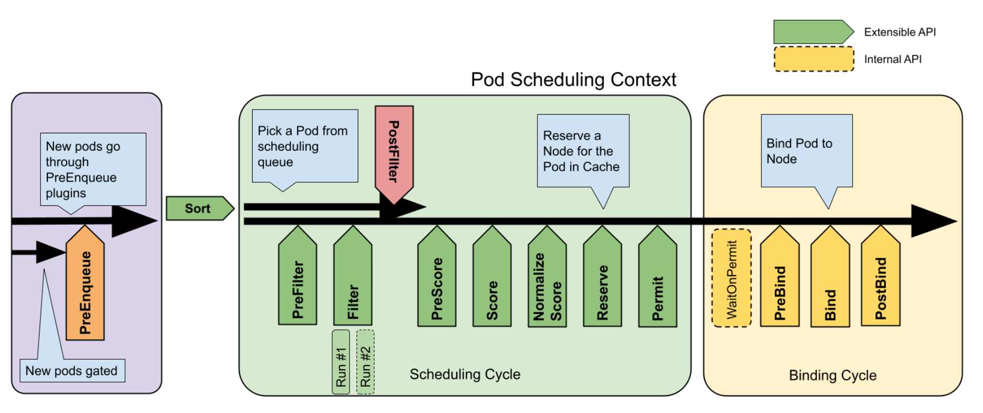
Scheduler Framework
Filter: hard constraints
Score: pick the best node

Slide 7
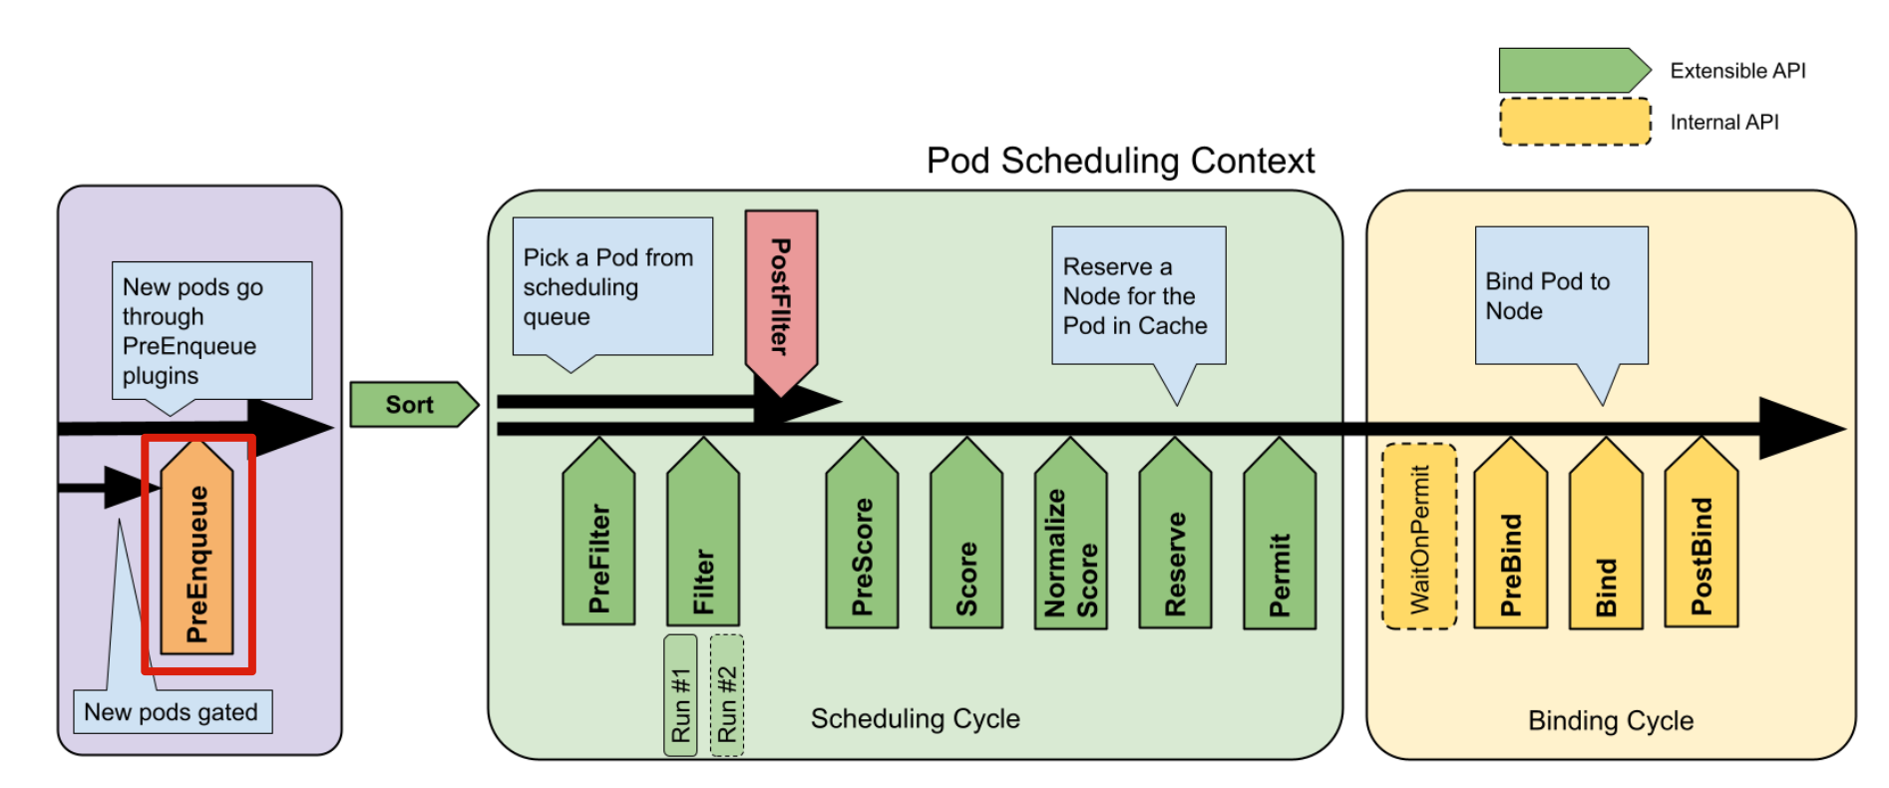
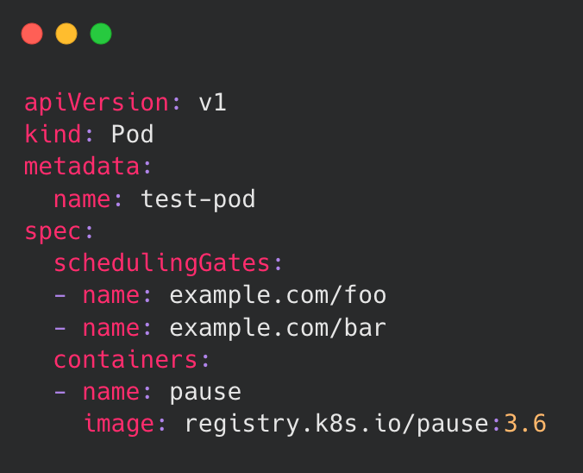
PreEnqueue
Plugins:
SchedulingGates
Pod Scheduling Readiness, introduced in Kubernetes1.26.
Tell the scheduler when a Pod is ready to be considered for scheduling.

Slide 8
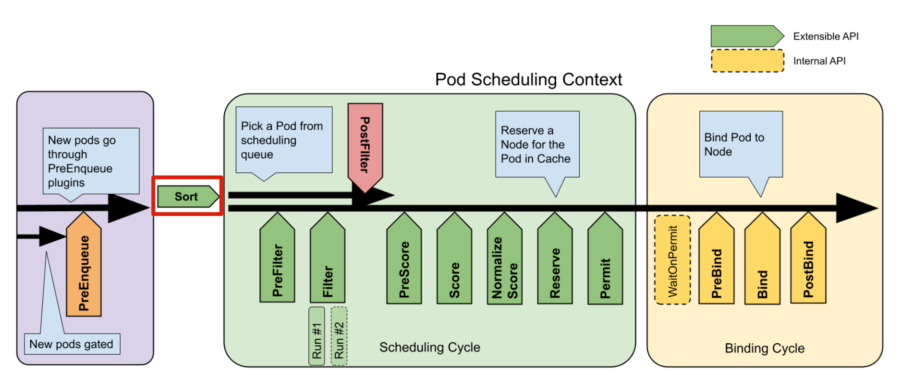
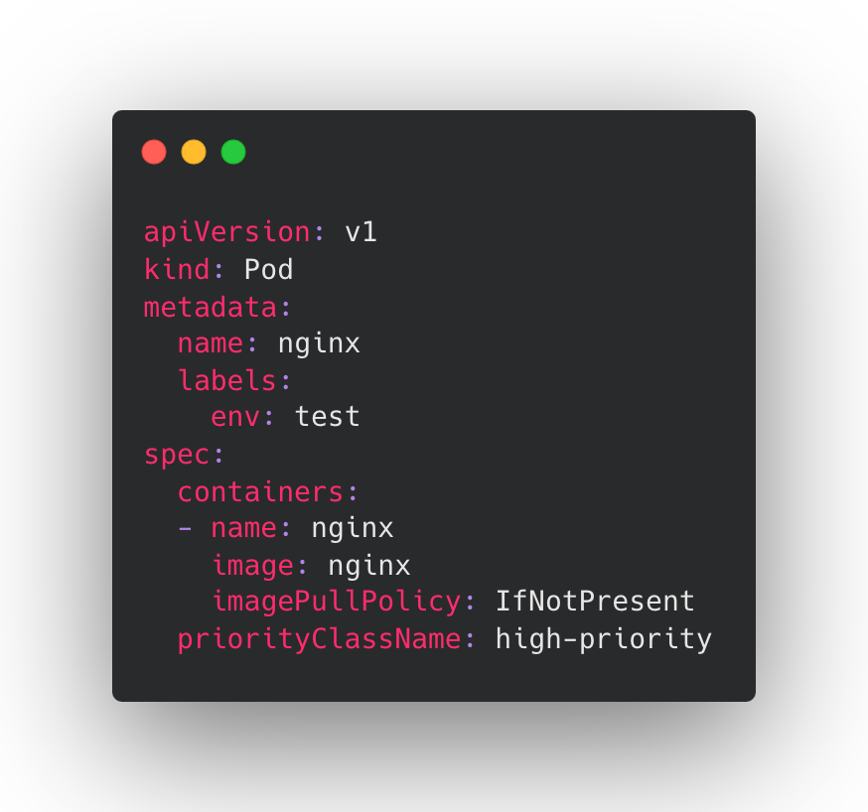
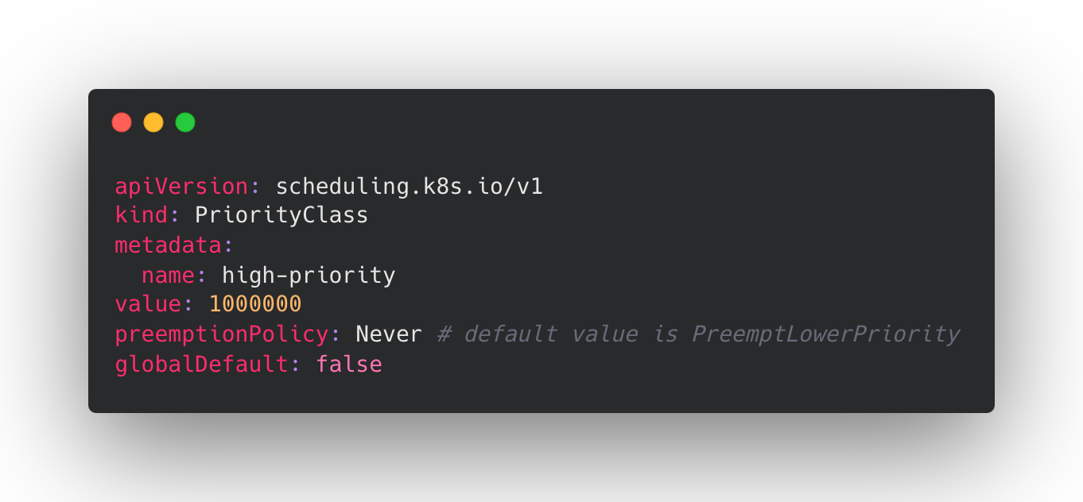
QueueSort
Plugins:
PrioritySort
It sorts pods based on their priority. When priorities are equal, it
compares pod created timestamp.
Only one queue sort plugin may be enabled at a time.

Slide 9
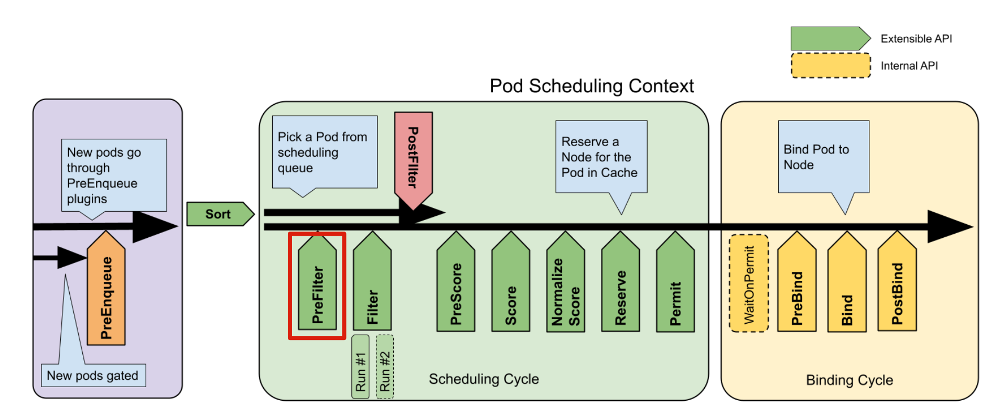
PreFilter
Plugins:
NodeAffinity
NodePorts
NodeResourcesFit
VolumeRestrictions
nonCSILimits
CSILimits
VolumeBinding
VolumeZone
PodTopologySpread
InterPodAffinity
Pre-check if the Pod should proceed scheduling.
Pre-calculation of cycleState (for Filter / PostFilter).
Parallelize processing if needed.

Slide 10
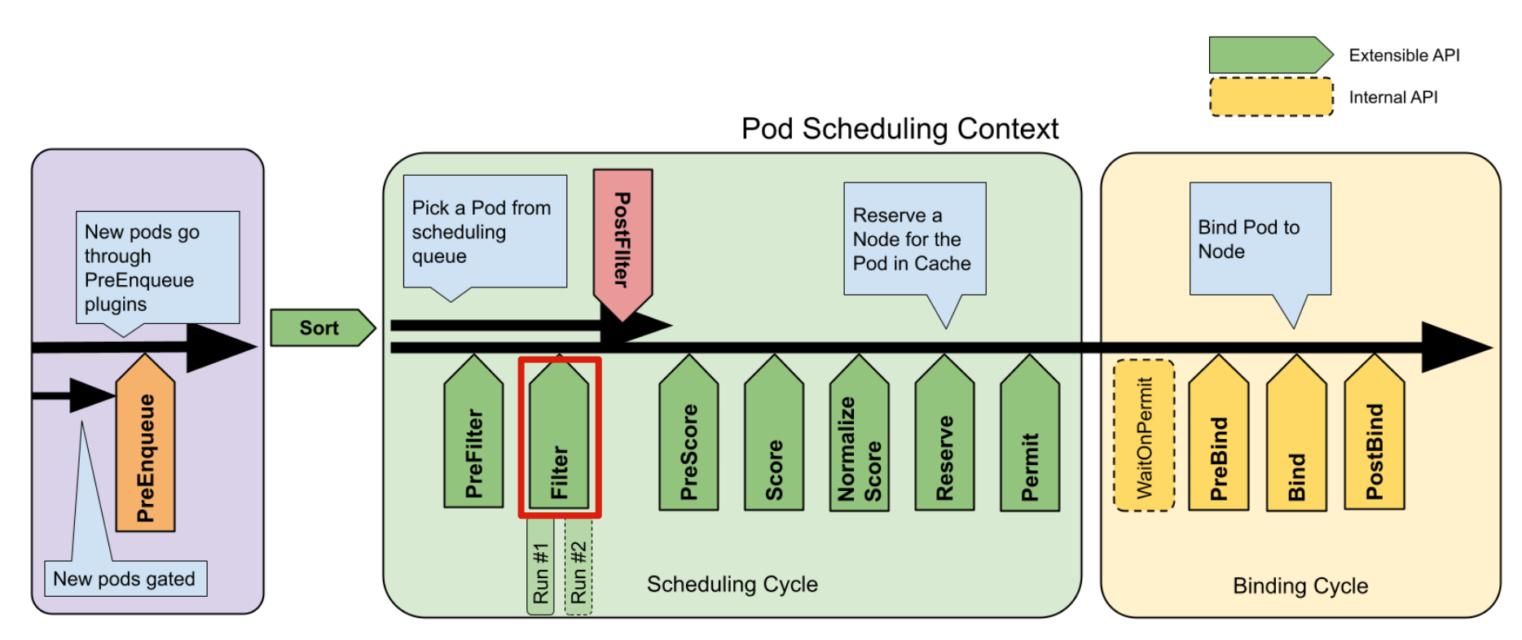
Filter
Plugins:
NodeUnschedulable
NodeName
TaintToleration
NodeAffinity
NodePorts
NodeResourcesFit
VolumeRestrictions
nonCSILimits(EBSLimits, GCEPDLimits, AzureDiskLimits)
CSILimits
VolumeBinding
VolumeZone
PodTopologySpread
InterPodAffinity
Filter out nodes that cannot run the Pod.
Nodes may be evaluated concurrently.
Leverage pre-calculated cycleState if needed.
If any filter plugin marks the node as infeasible, the remaining plugins will not be called for that node.

Slide 11
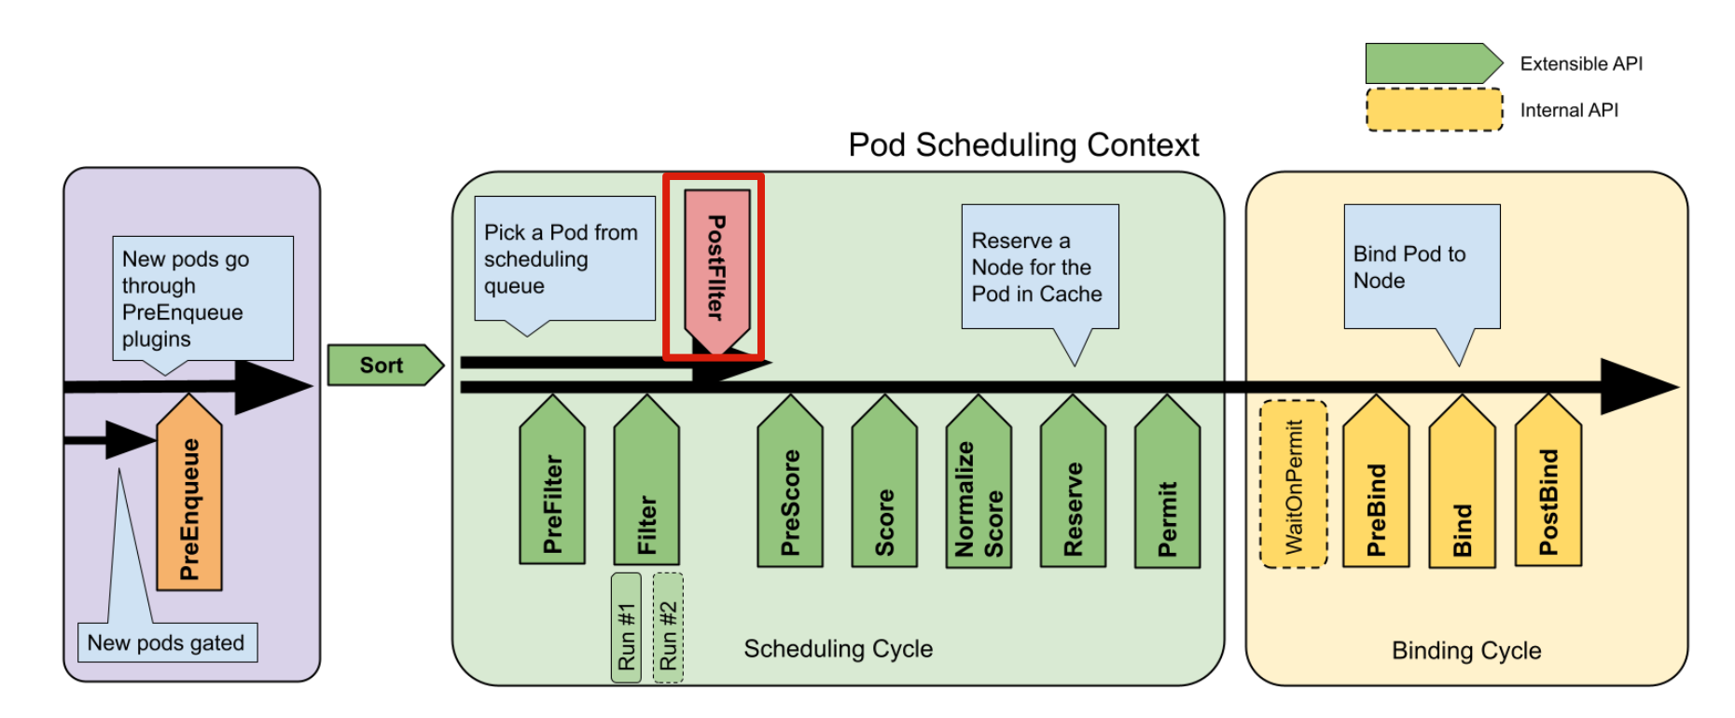
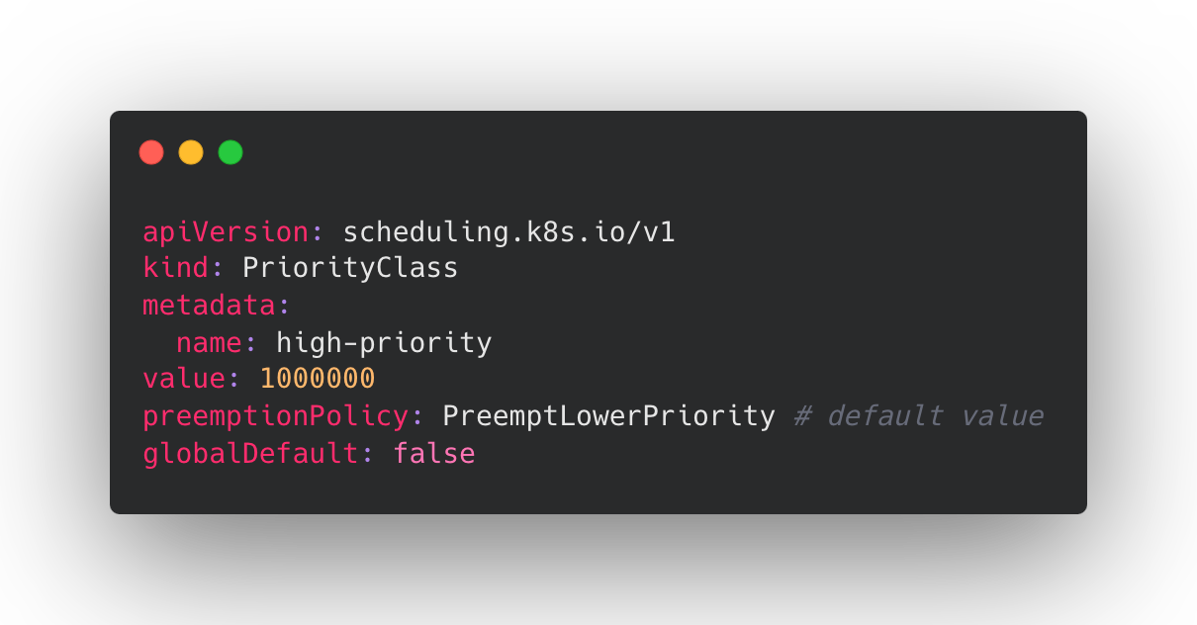
PostFilter
Plugins:
DefaultPreemption
A typical PostFilter implementation is preemption,
which tries to make the pod schedulable by preempting other Pods.

Slide 12
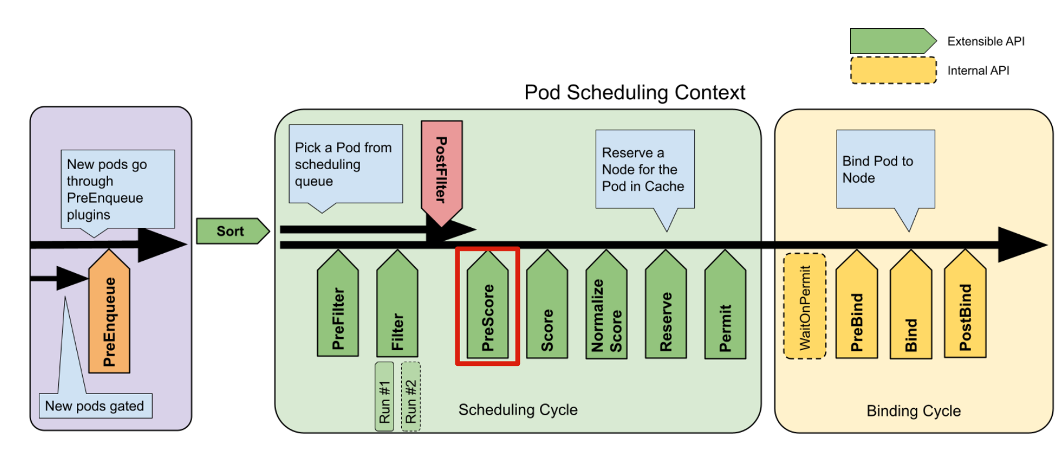
PreScore
Plugins:
TaintToleration
NodeAffinity
NodeResourcesFit
PodTopologySpread
interPodAffinity
BalancedAllocation
A Pre-calculation of cycleState(for Score/NormalizeScore).
Parallelize processing if needed.

Slide 13
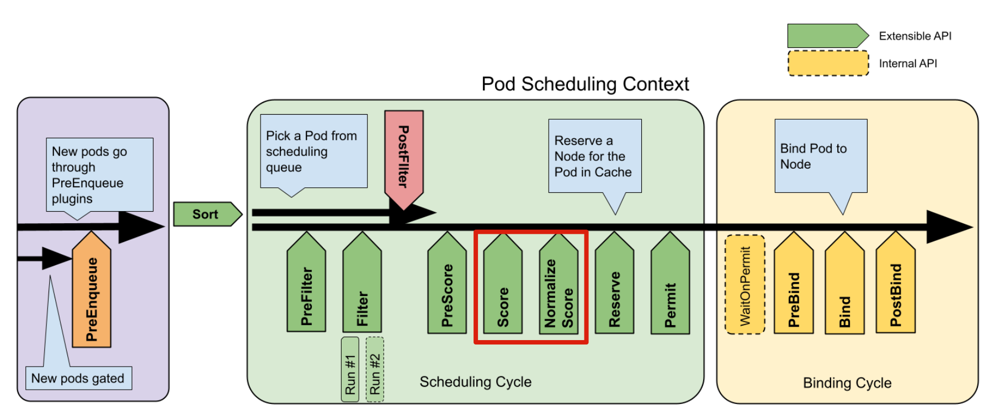
Score/NormalizeScore
Plugins:
TaintToleration
NodeAffinity
NodeResourcesFit
VolumeBinding
PodTopologySpread
interPodAffinity
BalancedAllocation
ImageLocality
Score:
The scheduler will call each Score plugin for each node.
Leverage pre-calculated cycleState if needed.
NormalizeScore:
NormalizeScore is called for all node scores produced by the same plugin‘s “Score” method.
Convert the final score between [0,100].
percentageOfNodesToScore: percentage of all nodes used for searching for feasible nodes, its default value is calculated based on the cluster size.
percentage = 50 - numAllNodes/125
The minimum of nodes to scan is 5% of the total or 100 nodes.
Example:
2500 nodes in the cluster: 50 – (2500/125) = 30%

Slide 14
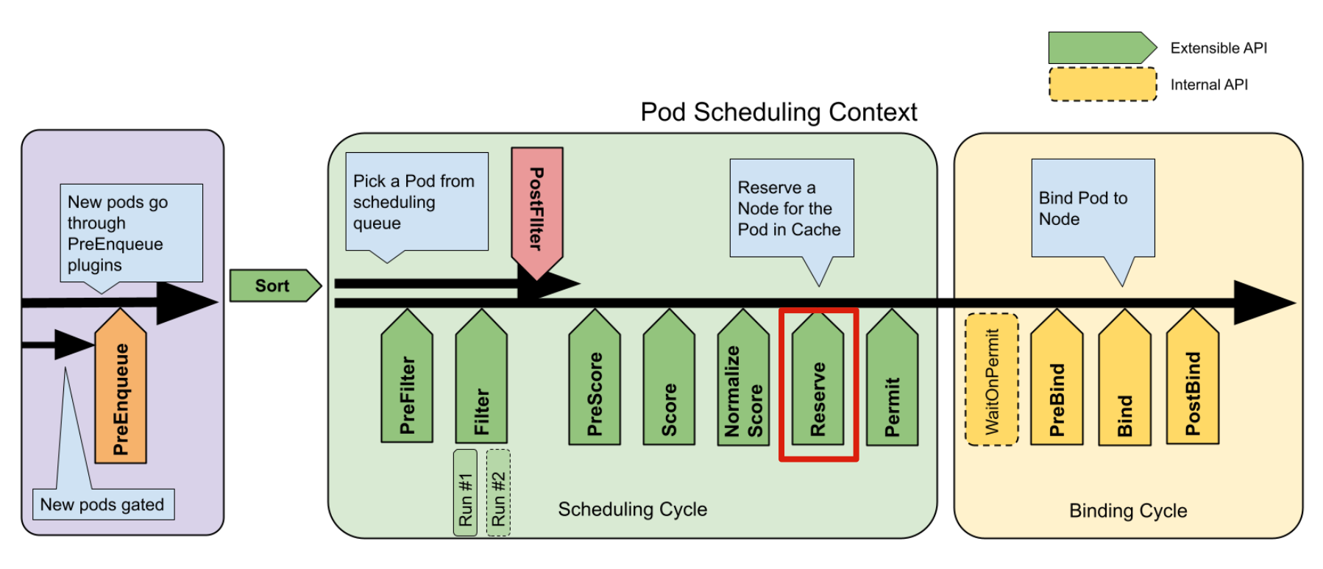
Reserve/UnReserve
Plugins:
VolumeBinding
Temporarily reserve Pod resources in the scheduler cache.
Designed for optimistic concurrency.
The Unreserve phase is triggered if the Reserve phase or a later phase fails.

Slide 15
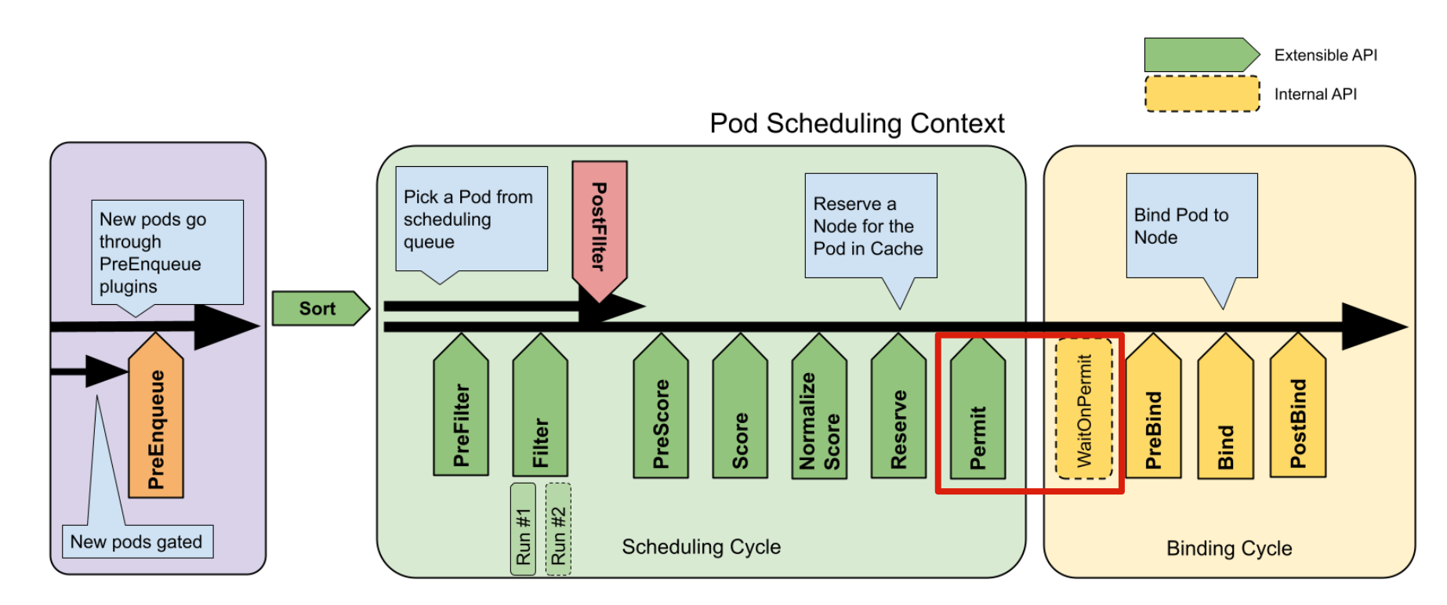
Permit
Permit plugins are used to prevent or delay the binding of a Pod.
Typically used to schedule a group of Pods that have inter-dependencies.
WaitOnPermit will block, if the pod is a waiting pod, until the waiting pod is rejected or allowed.

Slide 16
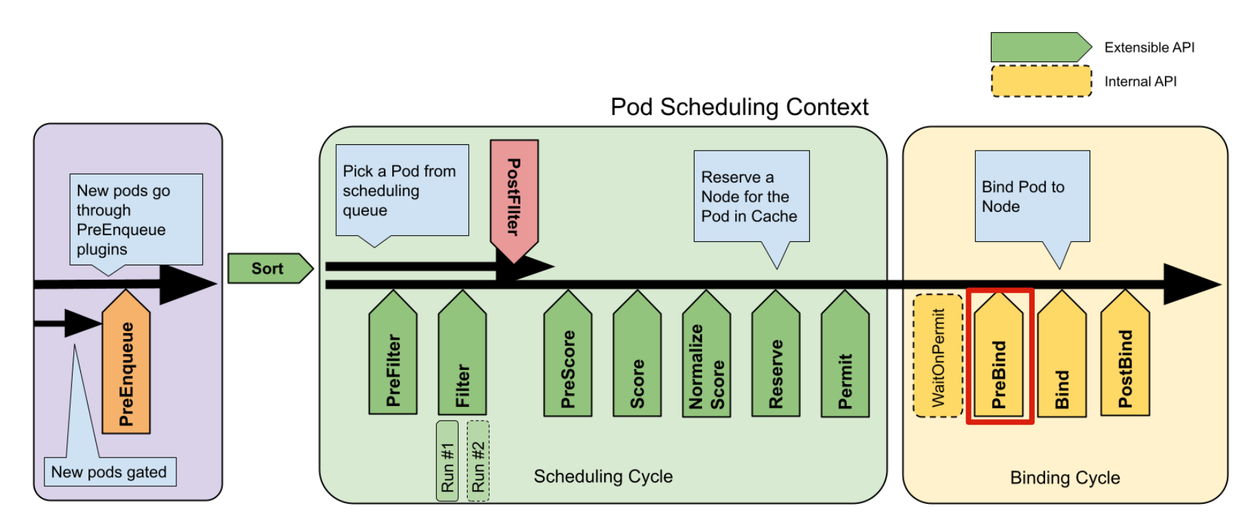
PreBind
Plugins:
VolumeBinding
Typically used to ensure a Pod's dependent resources are ready (e.g. VolumeBinding).
Call Unreserve to cleanup resources if needed.

Slide 17
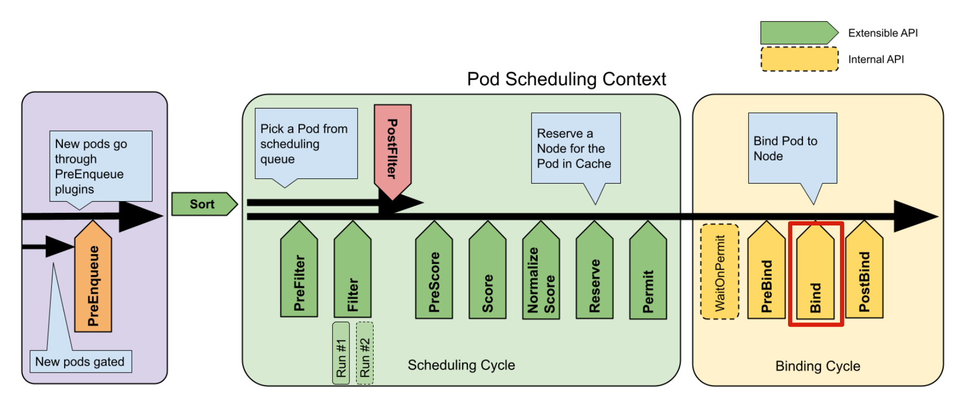
Bind
Plugins:
DefaultBinder
Bind a Pod to a Node, add spec.nodeName.
Call Unreserve to cleanup resources if needed.

Slide 18
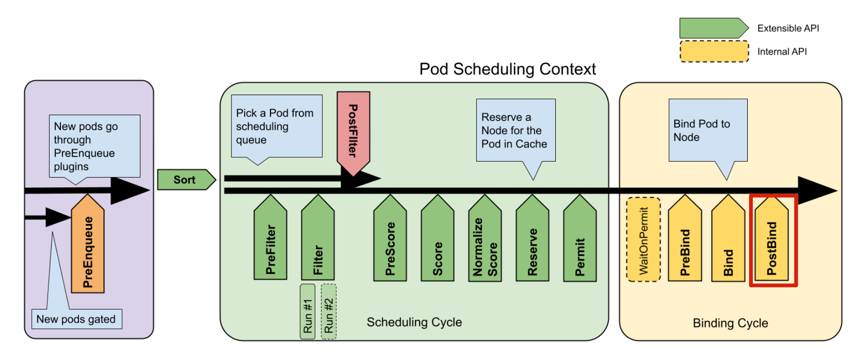
PostBind
Postbind plugins are called after a Pod is successfully bound.
Usually for informational purposes, like logging.

Slide 19
Write a Scheduler Plugin

Slide 20
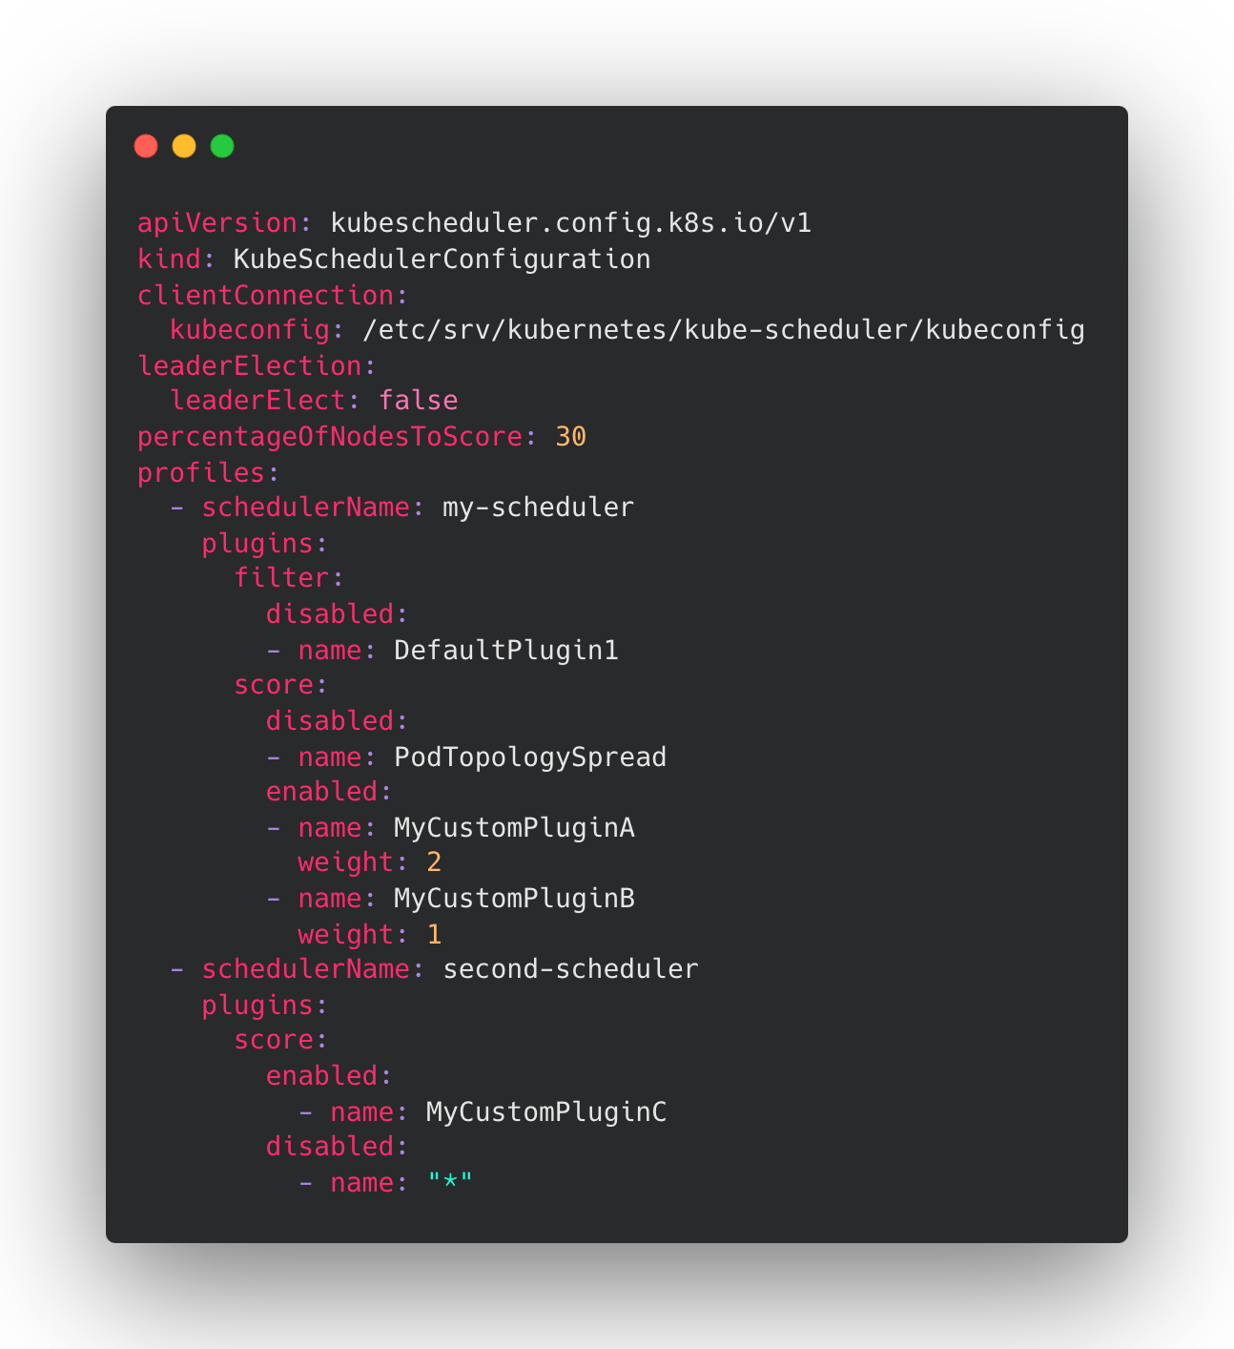
Scheduler Configuration
Configurations:
Global parameters
Per plugin configuration
Multiple profiles

Slide 21
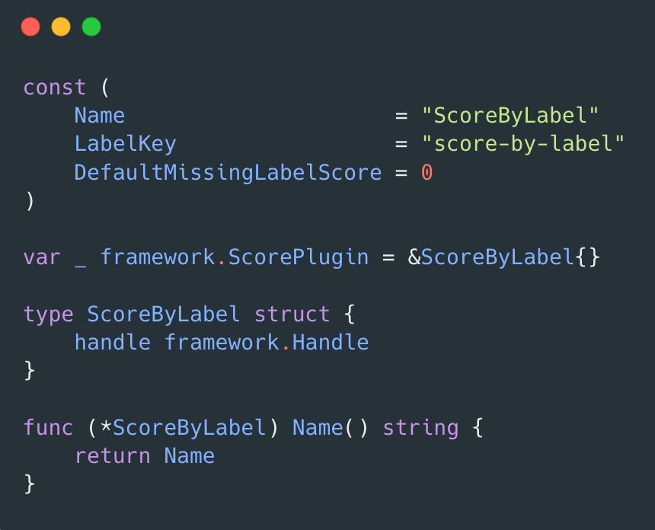
Define Score Plugin Struct

Slide 22
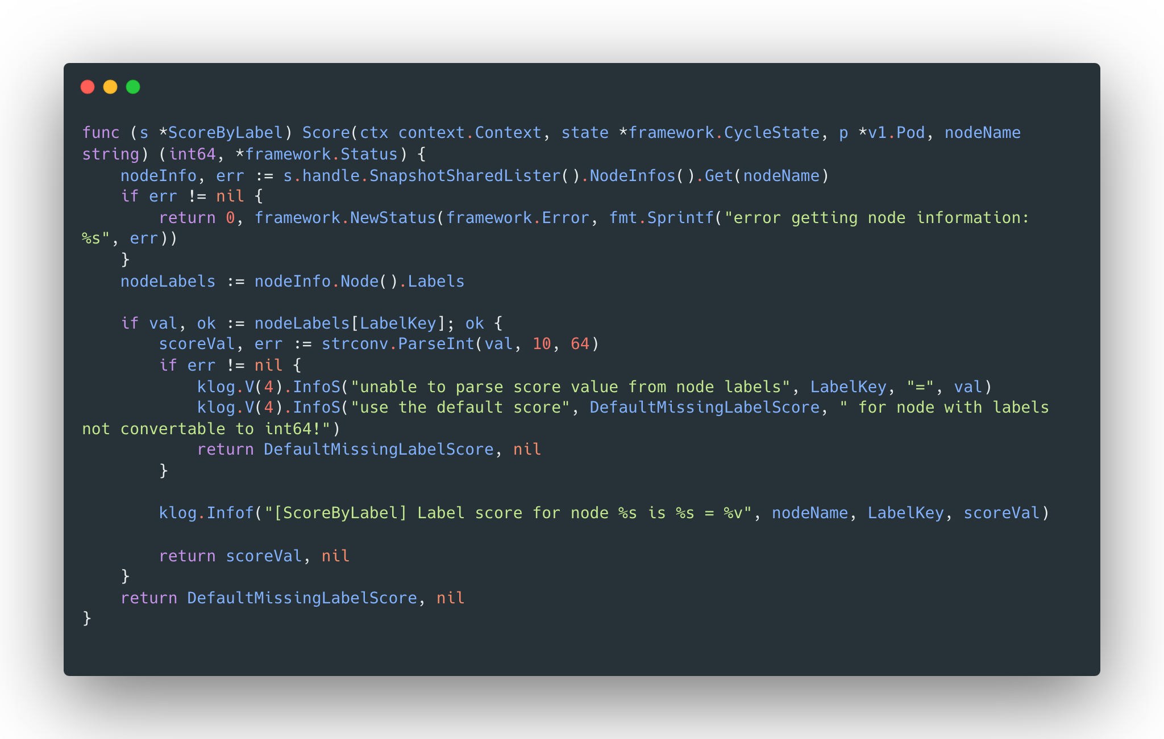
Write Score Function

Slide 23
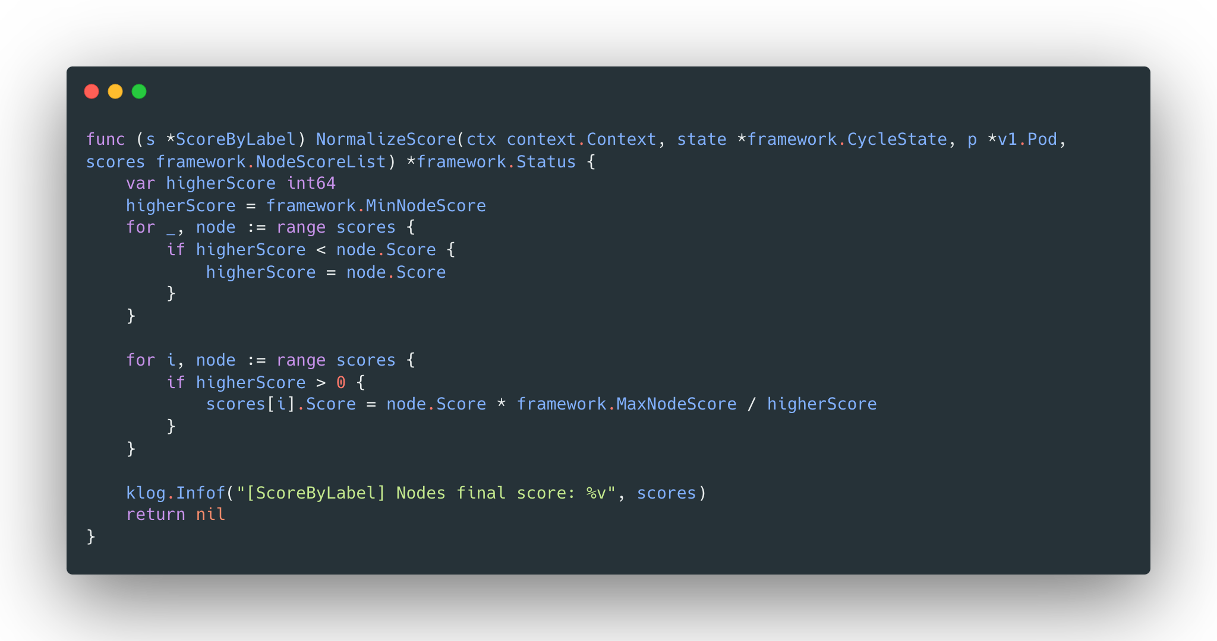
Write NormalizeScore Function

Slide 24
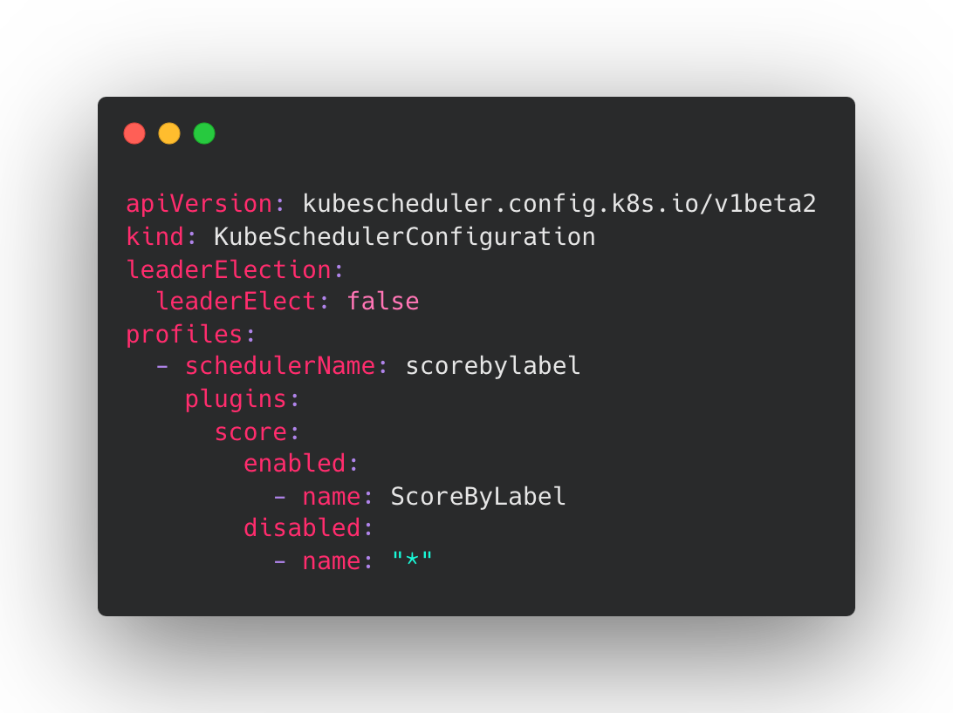
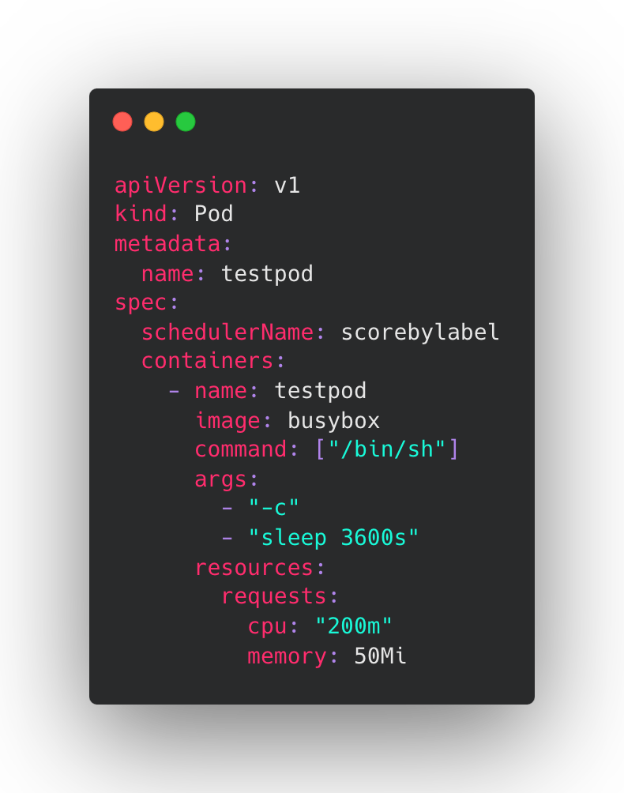
Run the scheduler as a secondary scheduler

Slide 25
Sig-Scheduling subprojects

Slide 26
Scheduler-plugins
kubernetes-sigs/scheduler-plugins contains out-of-tree scheduler plugins based on scheduler framework.
Capacity Scheduling
Coscheduling
Node Resources
Node Resource Topology
Preemption Toleration
Trimaran
Network-Aware Scheduling

Slide 27

Kueue
kubernetes-sigs/kueue: Kueue is a cloud-native job queueing system for batch, HPC, AI/ML. Kueue has these core features:
Job management with queueing policies(FIFO, BestEffort, Preemption)
Multi-Tenant support
Resource quota management with fair-sharing semantics
Resource fungibility in heterogeneous clusters
Two-Stage admission(budget, node scaling, etc.)

Slide 28
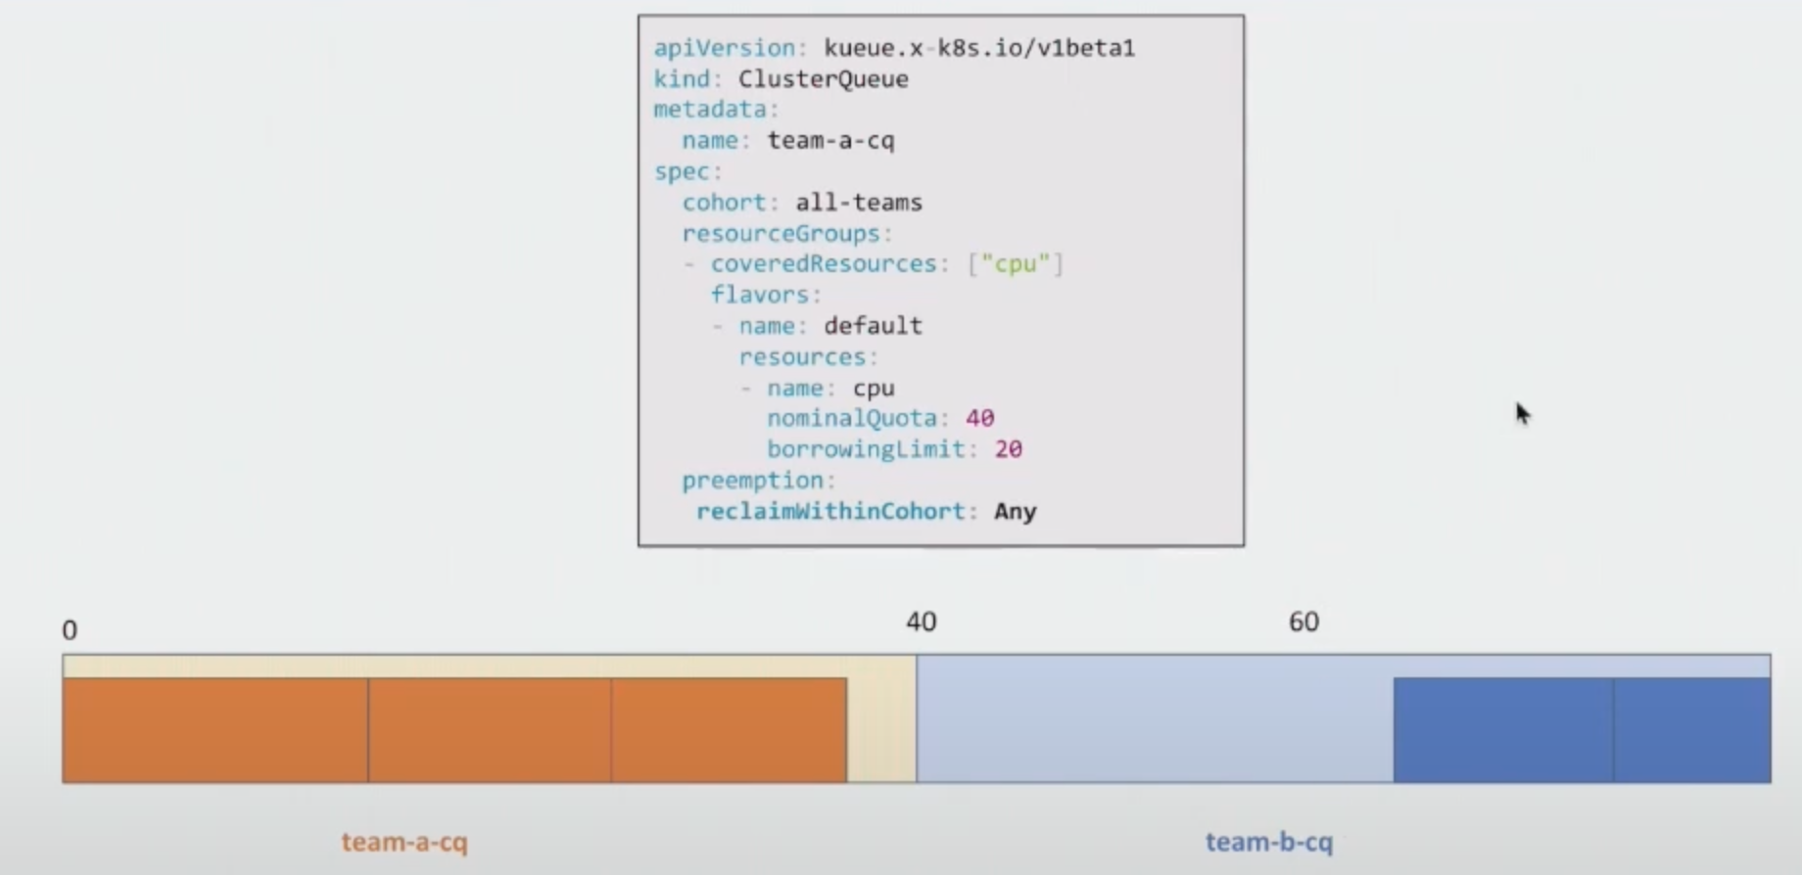
Kueue
Use case: Borrowing and cohort Preemption

Slide 29
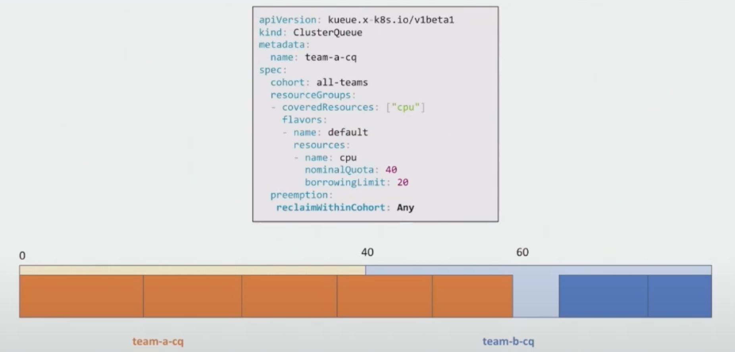
Kueue
Use case: Borrowing and cohort Preemption

Slide 30
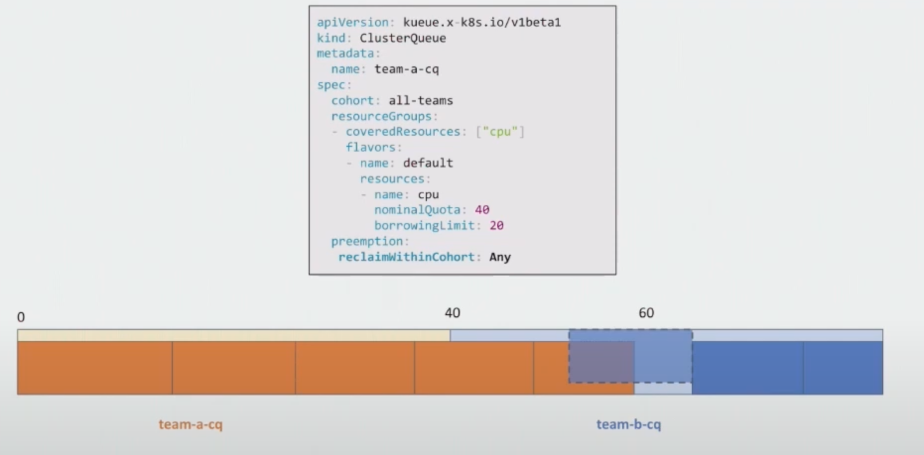
Kueue
Use case: Borrowing and cohort Preemption

Slide 31
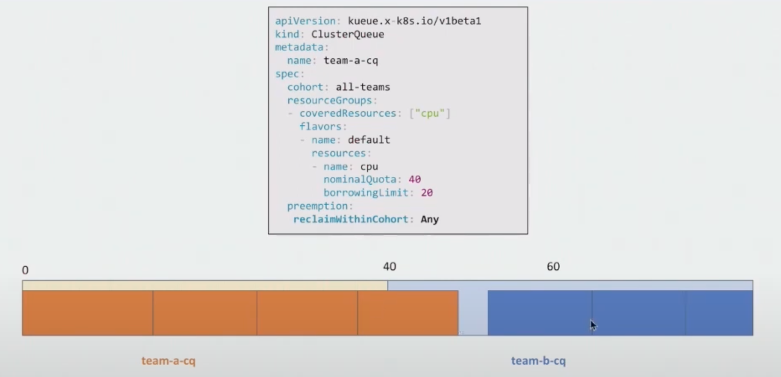
Kueue
Use case: Borrowing and cohort Preemption

Slide 32
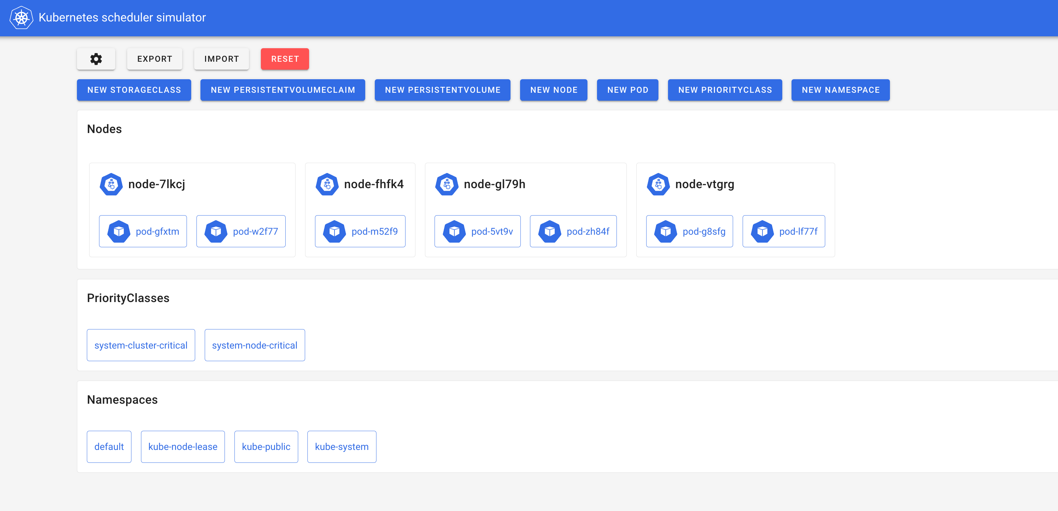
Kube-scheduler-simulator
kubernetes-sigs/kube-scheduler-simulator: test your scheduler without preparing a real cluster.

Slide 33
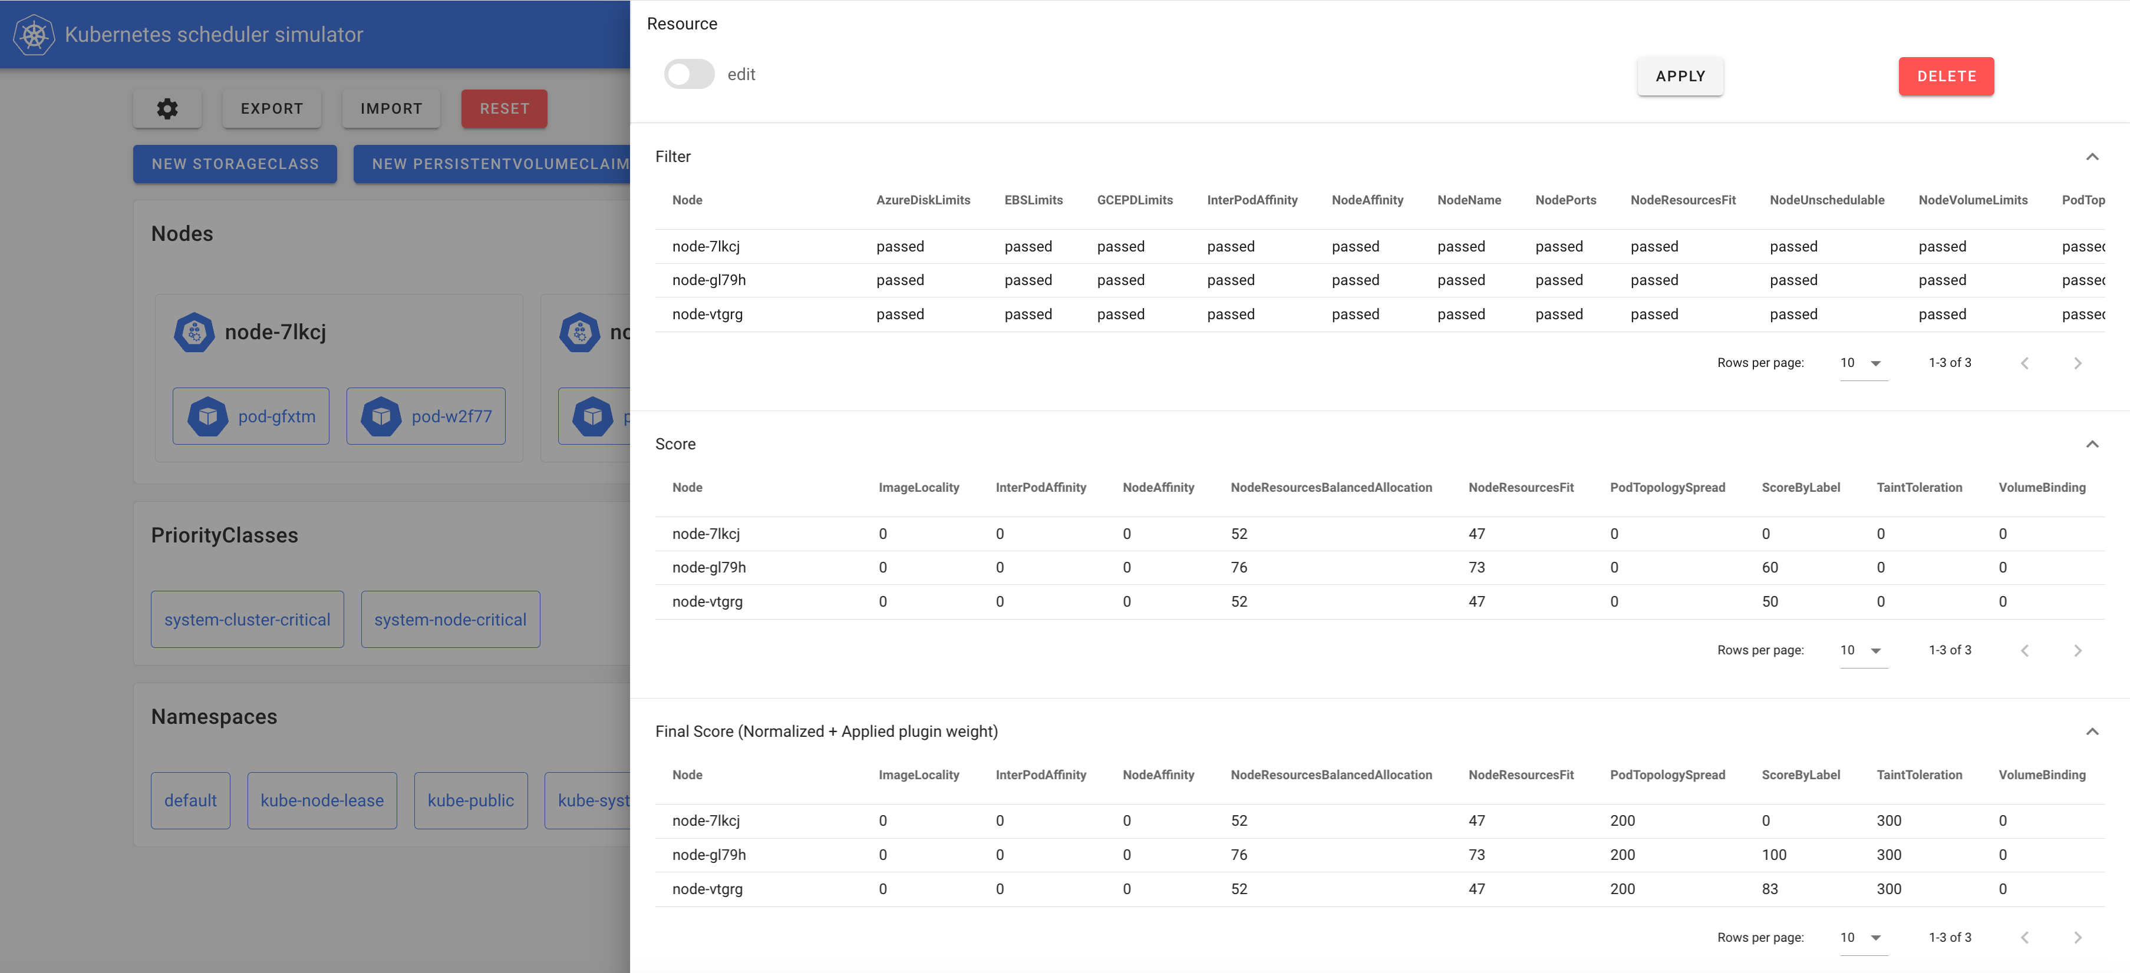
Kube-scheduler-simulator

Slide 34

Descheduler
kubernetes-sigs/descheduler: Descheduler is used to rebalance clusters by evicting pods that can potentially be scheduled on better nodes. Some scenarios:
Some nodes are under or over utilized.
The original scheduling decision does not hold true any more, as taints or labels are added to or removed from nodes, pod/node affinity requirements are not satisfied any more.
Some nodes failed and their pods moved to other nodes.
New nodes are added to clusters.

Slide 35

Kwok(Kubernetes WithOut Kubelet)
kubernetes-sigs/kwok: Simulates thousands of Nodes and Clusters. You don’t need to start real Nodes or Pods to check the behaviors of Scheduler, Cluster Autoscaler, or any controllers.

Slide 36
Thank You

